Slide 1



E-Book Store
Project ID:21236
By
Student 1: Biswajeet Padhi Roll No: CSE201712417
Student 2: Shyailesh Mishra
Roll No: CSE201710418
Under the guidance of
Mrs. Manali Sarkar
Biswajeet Padhi (Roll#CSE201712417) & Shyailesh Mishra (Roll#CSE201710418)
Notes:
B-TECH PROJECT MID-SEM PRESENTATION 2011
BY KHUSHBU KHAN & ISAN SAHOO

Slide 2
Outline
Introduction
Benefits
Features
Sequence Diagram
Use case Diagram
Architecture
Tools/Softwares
References
Biswajeet Padhi (Roll#CSE201712417) & Shyailesh Mishra (Roll#CSE201710418)
Notes:
B-TECH PROJECT MID-SEM PRESENTATION 2011
BY KHUSHBU KHAN & ISAN SAHOO
2

Slide 3
Introduction
E-Book store is a Digital platform, in which user can access books
In digital form.
Both free a paid books are available in digital format. Free books
can be accessed by the user in pdf format for free of cost and for paid book user has to purchase.
Biswajeet Padhi (Roll#CSE201712417) & Shyailesh Mishra (Roll#CSE201710418)

Slide 4
Benefits
Convenience of E-Book over Physical Book
Hassle free reading
Taking Digital notes
Better Time utilization
Biswajeet Padhi (Roll#CSE201712417) & Shyailesh Mishra (Roll#CSE201710418)

Slide 5
Features
Admin
Upload new books
Update Books
Remove Books
Demand Analysis
User (Reader)
Search Books (By category, By author, by title)
Purchase Books
Note making
Reminder
Biswajeet Padhi (Roll#CSE201712417) & Shyailesh Mishra (Roll#CSE201710418)

Slide 6
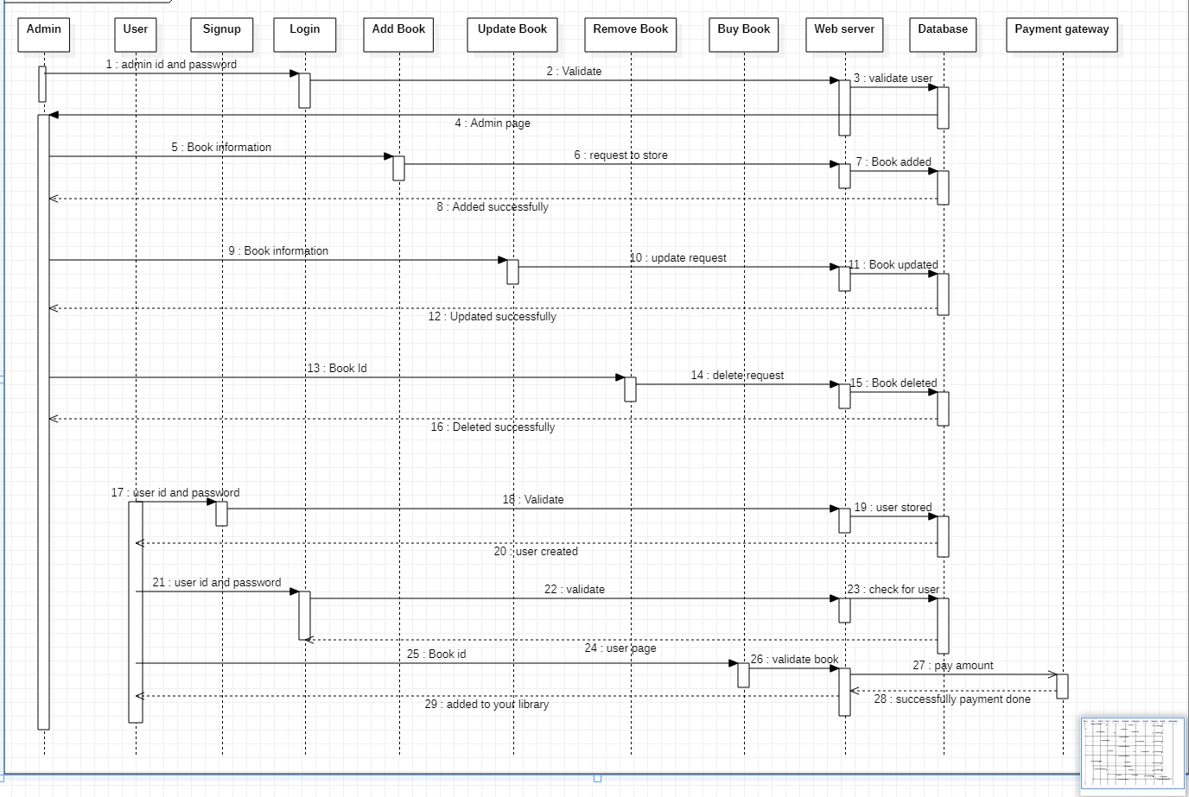
Sequence Diagram
Biswajeet Padhi (Roll#CSE201712417) & Shyailesh Mishra (Roll#CSE201710418)

Slide 7
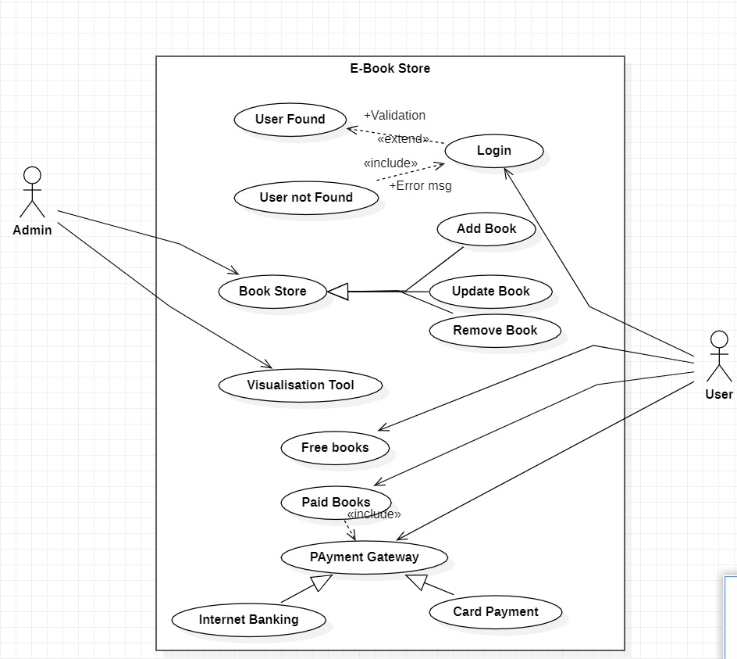
Use case Diagram
Biswajeet Padhi (Roll#CSE201712417) & Shyailesh Mishra (Roll#CSE201710418)

Slide 8
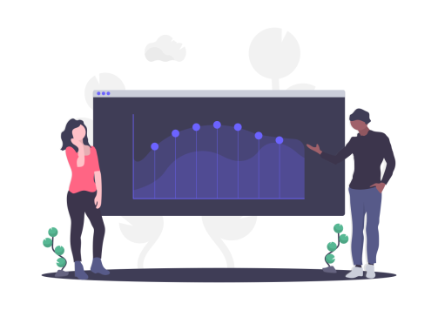
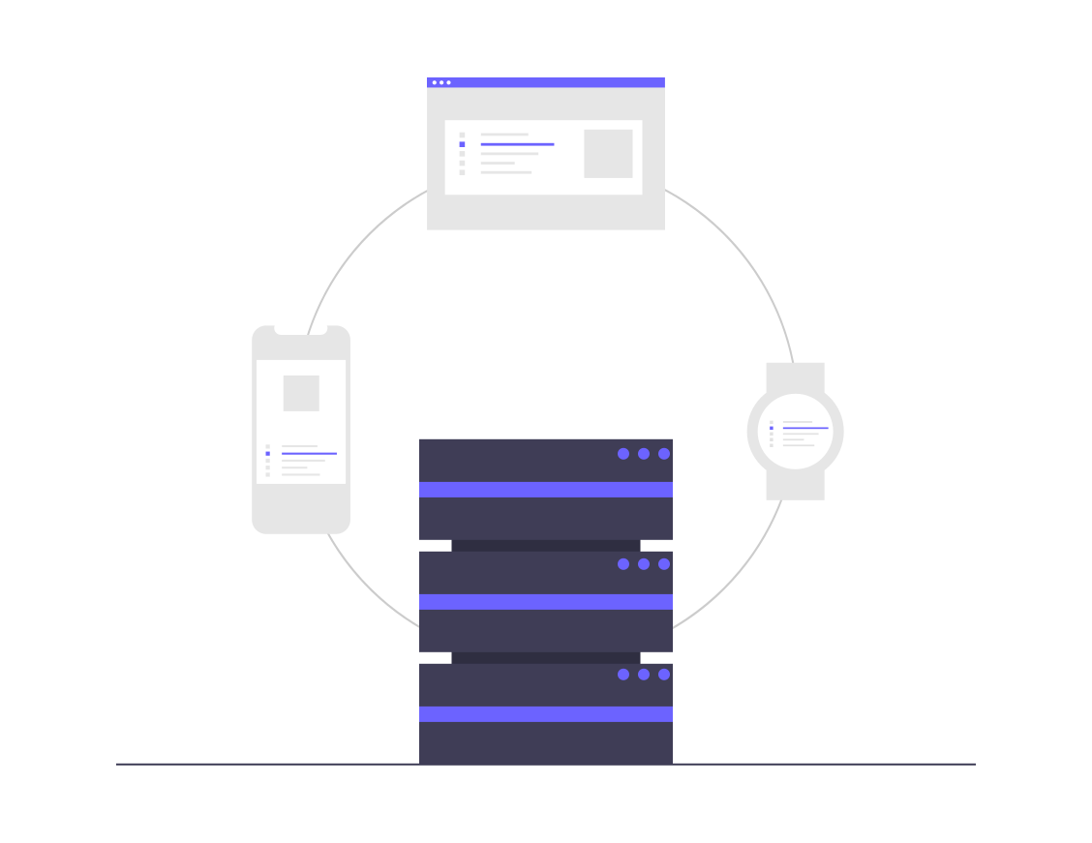

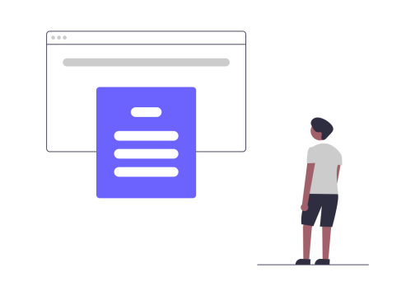
Architecture
Admin
Server
Database
Reader
Biswajeet Padhi (Roll#CSE201712417) & Shyailesh Mishra (Roll#CSE201710418)

Slide 9






Tools/Softwares
Frontend
React Js
Backend
Node Js
MongoDB
Express Js
Testing
Postman
IDE
Visual Studio Code
Biswajeet Padhi (Roll#CSE201712417) & Shyailesh Mishra (Roll#CSE201710418)

Slide 10
Reference
[1] Kaplan, R. ed., 2012. Building and Managing E-book Collections: A How-to-do-it Manual for Librarians (No. 184). American Library Association.
[2] Gustman, S., Survivors of Shoah Visual History Foundation, 2000. Digital library system. U.S. Patent 6,092,080.
[3] Witten, Ian H., David Bainbridge, and David M. Nichols. How to build a digital library. Morgan Kaufmann, 2009.
Biswajeet Padhi (Roll#CSE201712417) & Shyailesh Mishra (Roll#CSE201710418)
Notes:
B-TECH PROJECT MID-SEM PRESENTATION 2011
BY KHUSHBU KHAN & ISAN SAHOO
10

